Slide 1
OPEN DATA
Universidad de Lleida; Massive Data Processing
February 19, 2023

Slide 2
OPEN DATA
Definition
We refer to a philosophy and practice that proposes that data should be freely accessible to the public, able to be used without the restrictions imposed by copyright, patents, etc.
This movement is aligned with other 'open' movements
Free Open Source Software
Open Hardware
Open Science/ Open Access
Open Content / Creative Commons
We will consider data to be open when anyone is free to use them, reuse them, redistribute them, subject only, at most, to the requirement of attributing and/or sharing alike

Slide 3
OPEN DATA
Motivation
In the age of instant, ubiquitous, universal, and nearly free access to all knowledge/content produced by humanity, what do you think about laws that focus on preventing the dissemination of this type of knowledge (data)?

Slide 4
OPEN DATA
Motivation
In the age of instant, ubiquitous, universal, and nearly free access to all knowledge/content produced by humanity, what do you think about laws that focus on preventing the dissemination of this type of knowledge (data)?
To counteract this movement towards compartmentalization, privatization, and data lockdown that is being driven by the current legal situation and future trends, a set of 'open' initiatives has emerged.
Some data are generated in processes funded with public money, which is why many believe they should be accessible to the public:
Public research data
Data generated/collected by the government (at all levels).
Advocates of open data argue that providing public access to these data is, in fact, giving owners access to data they already have.

Slide 5
OPEN DATA
Motivation
Regarding data funded with public funds, there are arguments against publication:
Charging for access to the data will help recover costs.
Public funding should not challenge private activities.
Non-profit organizations can obtain funding by charging for data access.
Privacy issues.
Some argue that charging for access to data will be a more efficient use of taxpayer funds.

Slide 6
OPEN DATA
Legality
In the United States, they follow common law practices.
Everything paid for with public funds should default to the public domain.
The European Union adopted Directive 2003/98/EC on the reuse of public sector information (PSI Directive) to encourage EU member states to make public information available for reuse by the general public.
In 2008, it became a mandatory implementation, and in 2013, it was amended to align with the principles of OpenData/OpenGovernment.

Slide 7
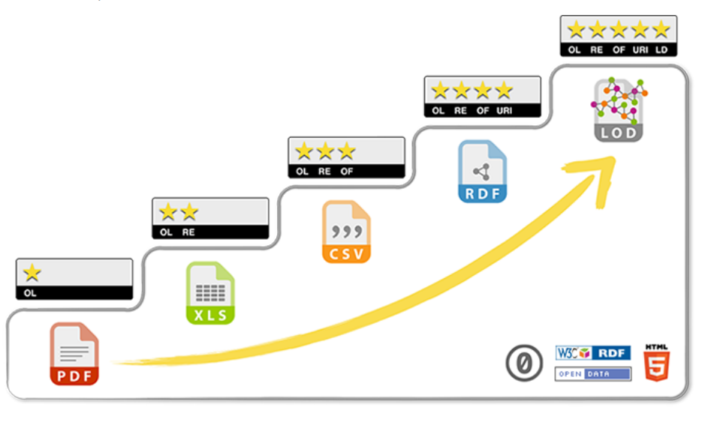
OPEN DATA
5 star data
Tim Berners-Lee proposed a classification 'by stars' according to how open the data and the linkability."

Slide 8
OPEN DATA
5 star data
Tim Berners-Lee proposed a classification 'by stars' according to how open the data and the linkability."
⭐ Data available on the web (in any format) under an open license.
⭐⭐ Structured data.
⭐⭐⭐ Data in a non-proprietary format.
⭐⭐⭐⭐ Use URIs to denote other things.
⭐⭐⭐⭐⭐ 'Link' our data to other data to provide context.

Slide 9
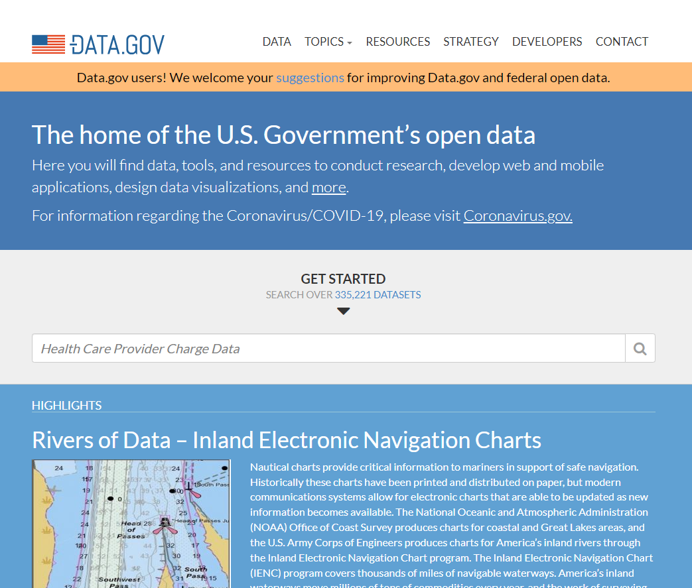
OPEN DATA -Examples
US Government Open data initiative:
http://www.data.gov/

Slide 10
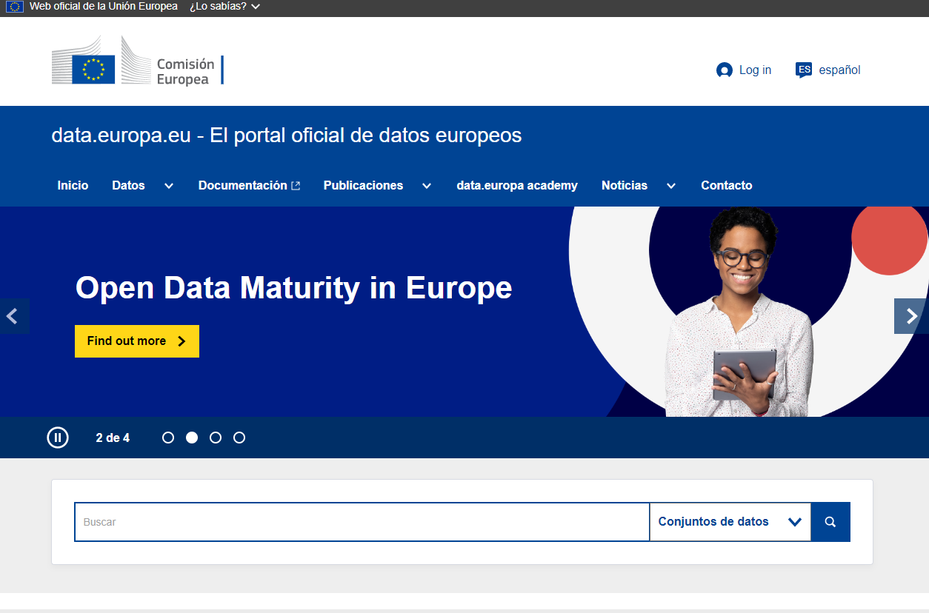
OPEN DATA -Examples
European Union Open Data Portal
https://data.europa.eu/es

Slide 11
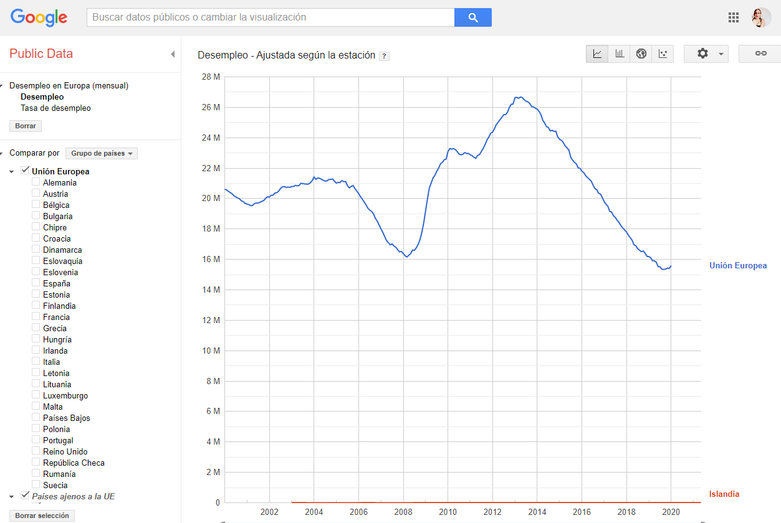
OPEN DATA -Examples
Google Public Data
https://www.google.com/publicdata/directory

Slide 12
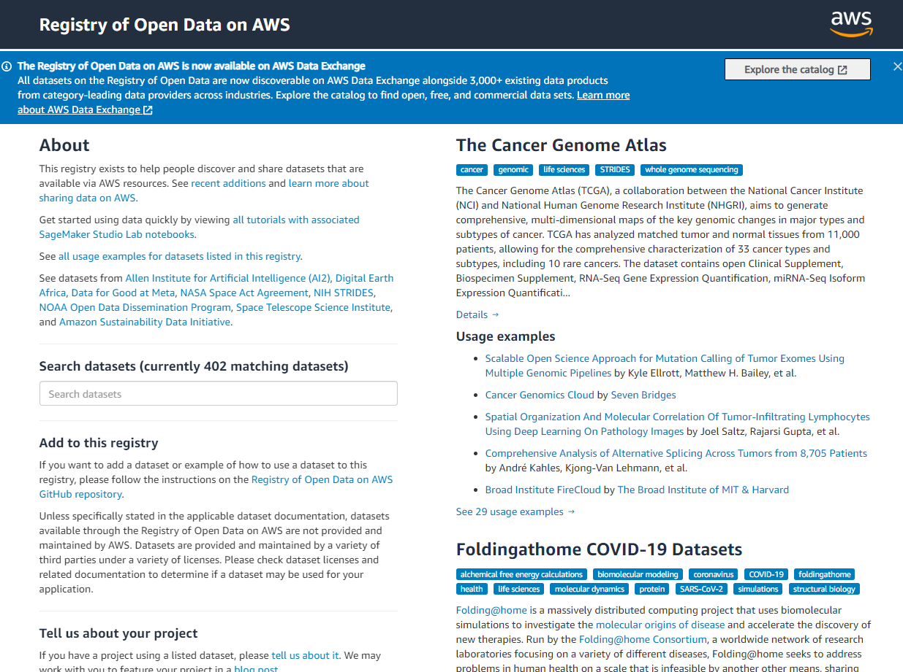
OPEN DATA -Examples
AWS Open Data
https://registry.opendata.aws/

Slide 13
Activity 1
Look for the following information
Energy efficiency certificates for existing buildings in Lleida.
List of accommodation facilities in the city of Barcelona.
What is available openly at Lleida City Council (paeria.es) - three examples.
Fuel consumption in Spain.
License plate numbers in Spain.
Provide documentation with access links to where you found this data, assign how many stars according to TBL's classification, and justify.

Slide 14
Linked Data
Definition
The linked data are those data published (on the web) in a structured format that
Facilitates linking between these data
Facilitates querying of these data through semantic queries.

Slide 15
Linked Data
Definition
The linked data are those data published (on the web) in a structured format that
Facilitates linking between these data
Facilitates querying of these data through semantic queries.
History of the web
Web 1.0: Documents from editors to people (unidirectional)
Web 2.0: Information from people to people
Web 3.0: Information for machines by machines for people

Slide 16
Linked Data
Definition
The linked data are those data published (on the web) in a structured format that
Facilitates linking between these data
Facilitates querying of these data through semantic queries.
History of the web
Web 1.0: Documents from editors to people (unidirectional)
Web 2.0: Information from people to people
Web 3.0: Information for machines by machines for people

Slide 17
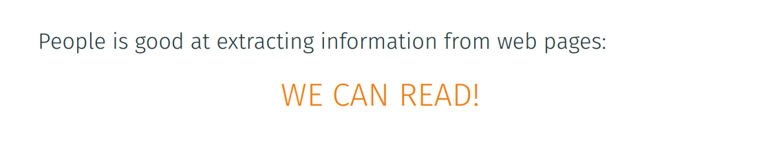
Linked Data
Definition
The linked data are those data published (on the web) in a structured format that
Facilitates linking between these data
Facilitates querying of these data through semantic queries.
History of the web
Web 1.0: Documents from editors to people (unidirectional)
Web 2.0: Information from people to people
Web 3.0: Information for machines by machines for people

Slide 18
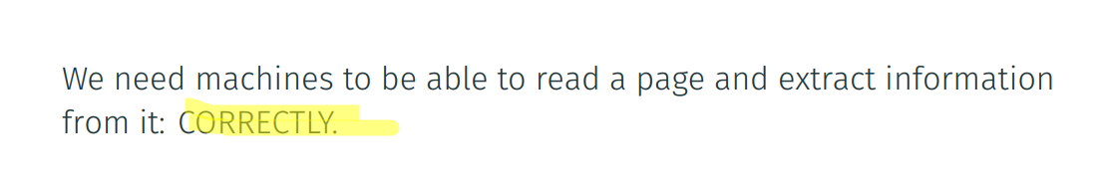
Linked Data
Definition
The linked data are those data published (on the web) in a structured format that
Facilitates linking between these data
Facilitates querying of these data through semantic queries.
History of the web
Web 1.0: Documents from editors to people (unidirectional)
Web 2.0: Information from people to people
Web 3.0: Information for machines by machines for people

Slide 19
Linked Data
Ambiguity
Search on Google:
MUSK
ATOM
RASPBERRY

Slide 20
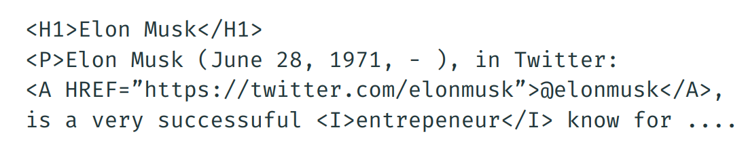
Linked Data
Ambiguity - Where is the problem?
In HTML (a markup language) we have two sets of information:
We have the 'content': 'June 20, 1971[...]'
We have the 'markup' or 'tag': H1, A....

Slide 21
Linked Data
Ambiguity - What can we understand?
From the content, we can 'extract' information: but in natural language (NLP is still a hot research topic, despite advances), so we have to deal with: ambiguity, errors, spelling mistakes, lack of context, etc.
From the markup, we can also 'extract' information: importance (H1), relationships (paragraph format), other sources (A), but we need more information: context, etc.
To solve the 'problem of lost information,' some proposals emerged, and the semantic web is one of them.
The semantic web proposes common data formats and protocols (especially RDF).
Definition according to W3C:
The Semantic Web provides a common framework that allows data to be shared and reused across application, enterprise, and community boundaries.

Slide 22
Linked Data
According to Tim Berners-Lee, it consists of:
Using URIs to name (identify) things.
Using HTTP URIs so that these things can be looked up (interpreted).
Providing useful information about what a name identifies when looked up, using open standards like RDF, SPARQL, etc.
Querying other things using their HTTP URI-based names when data are published on the web.

Slide 23

Linked Data
RDF
You can use HTML, XML, etc., to publish data, but they require prior knowledge of the metadata of this data to be useful.
RDF(Resource Description Framework) is a data model representation based on graphs that allows us to offer a standard representation of the data model adapted for the web (and Linked Data).
RDF describes data through a graph, where nodes represent data (subject/object) and edges represent relationships.
Thus, RDF represents data assertions as triplets, consisting of
On each of them is given as a URL/URI.

Slide 24
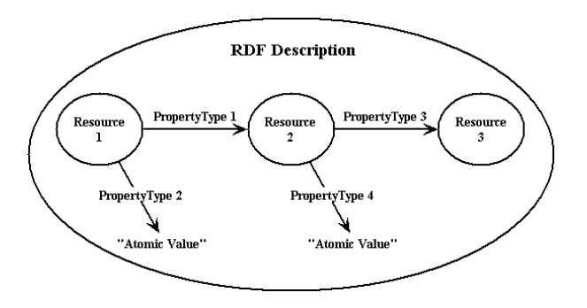
Linked Data
RDF - Model

Slide 25
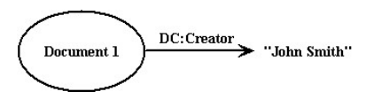
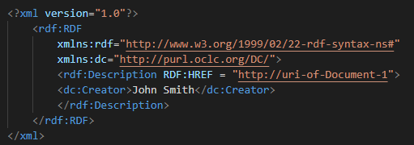
Linked Data
RDF - Example

Slide 26
Linked Data
According to Tim Berners-Lee, it consists of:
Using URIs to name (identify) things.
Using HTTP URIs so that these things can be looked up (interpreted).
Providing useful information about what a name identifies when looked up, using open standards like RDF, SPARQL, etc.
Querying other things using their HTTP URI-based names when data are published on the web.
Later he added a 5th component: Open Content.
And with that, we have Linked Open Data: data that are accessible, automatically processable, and open!

Slide 27
Bibliography
[1] Mateu, Carles. “Massive data processing”, Universitat de Lleida. Lleida. 2021.

Slide 28

QUESTIONS

Slide 29




¡THANK YOU!
alba.lamas@bluetab.net
¡Síguenos!
https://bluetab.net/
https://www.linkedin.com/company/bluetab/

